Slide 1
INFRASTRUCTURE USE CASE:C (Public Transport)
Using AI and Data to Improve sustainability of Public Transport by making it more profitable and optimised
Name:Mrinal Prakash Desai Company:VERTIV EMAIL:mrinal.datsci@gmail.com Ph:8177858692/9766129357

Slide 2


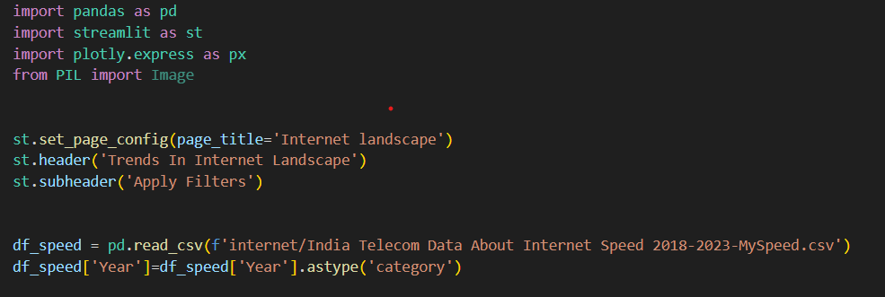


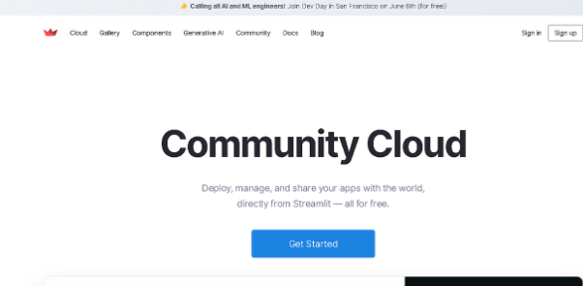
Technologies Used-Streamlit
Streamlit: Website Design and Deployment-All the Web Pages Forms will be deisigned in Streamlit. By using Various elements like Selectbox ,Multiselect, buttons etc. Different Visualisation Libraries have been used be used inside Steamlit. Pandas was used for data processing.
Folium and geopandas wwas use to provide Maps .Website has been deployed on Steamlit Community Cloud.

Slide 3
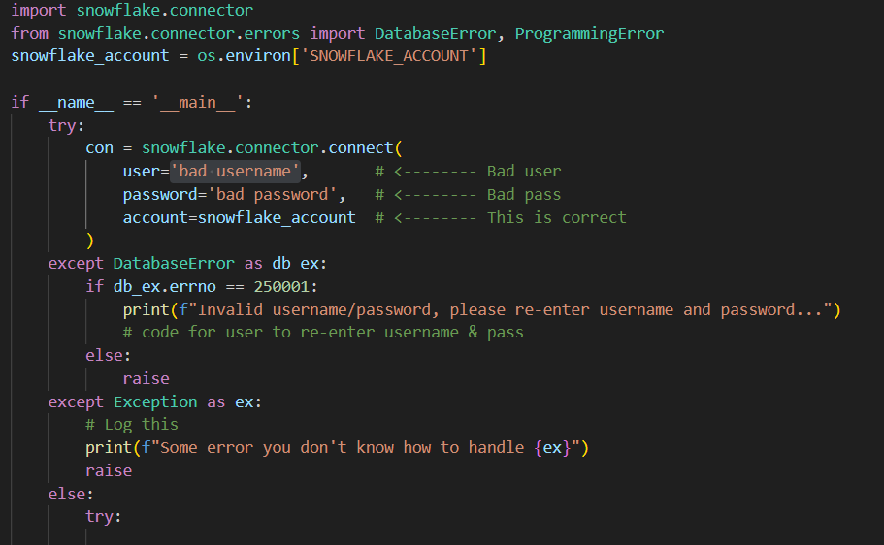
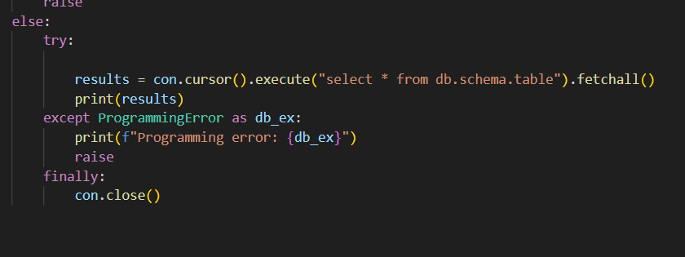
Error Handling
Error Handling is used in Varios Parts.Sbowflake
connector errors are used and accordingly
Exceptions are raised.

Slide 4
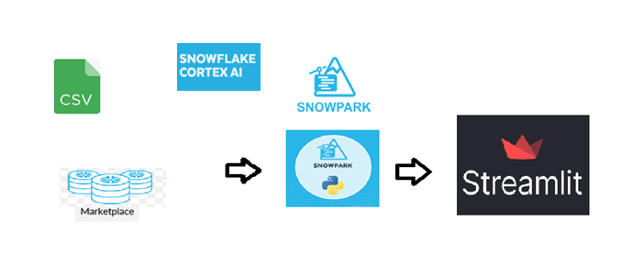







Hypothesis
Architecture Flow
According to national health survey the Ownership of private two wheelers is just 50% and Cars is 7% Across India.
This shows the dependency of vast section of population on Public Transport.
In this study we create an app to analyse various aspects of Public Transport including Railways and busses to discover ways and means to make it more sustrainable and profitable by finding ways to optimise the Transporation.
Technologies Used
<Add logos or names of languages / libraries / repositories / platforms used / cite data sources used>

Slide 5
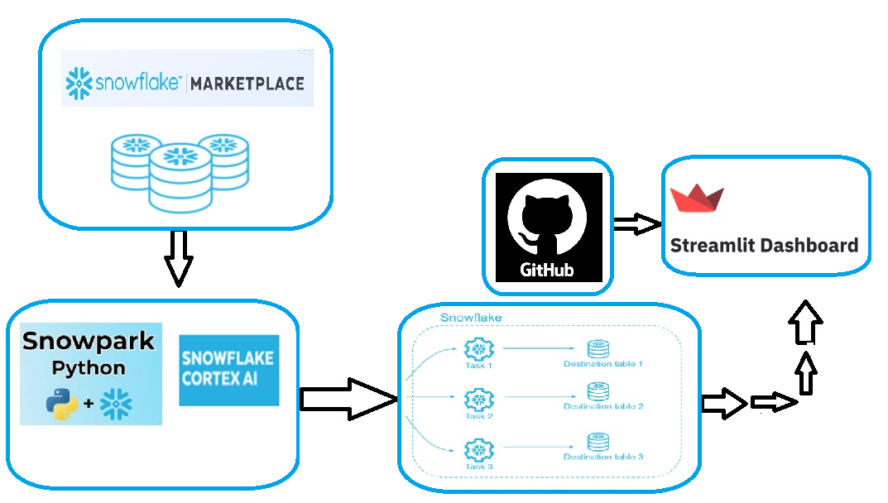
Architecture Flow

Slide 6
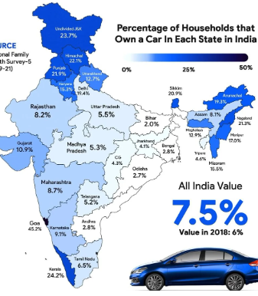
Insight and Recommendations #1
Insight
Title of Insight
We look at ways and means to make the Public Transportation more lucrative for population.
Giving them viable option.
< Insert Graph / Image / Video here >
Millions use public transport.

Slide 7
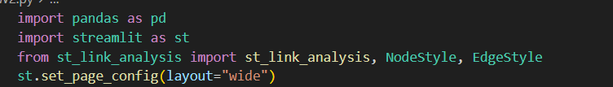
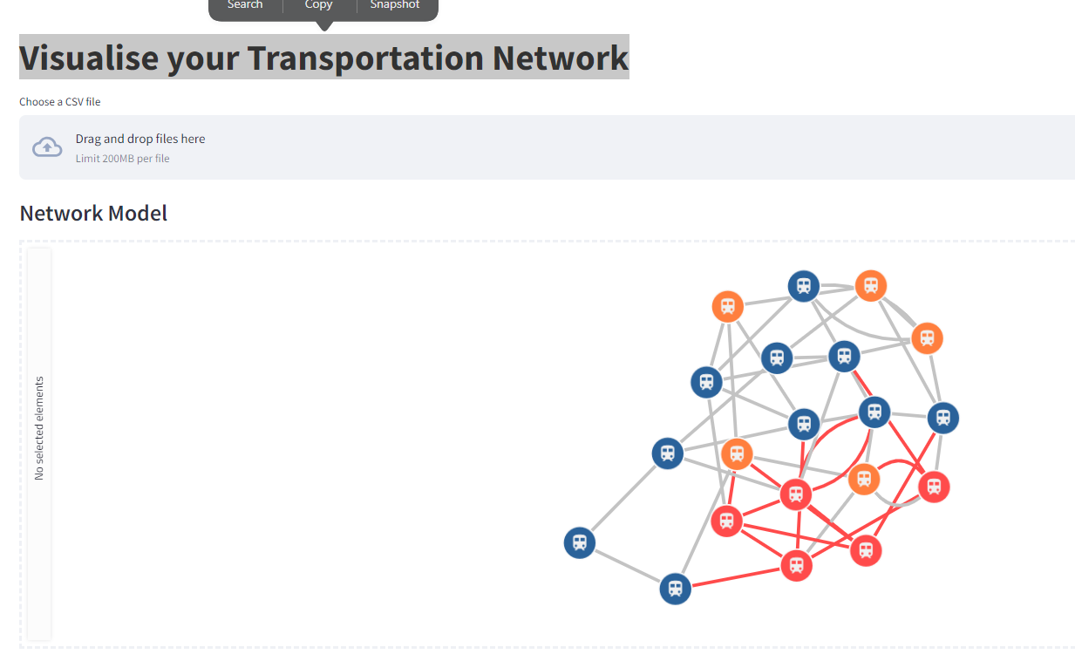
Route Analysis App
< Insert Graph / Image / Video here >
We create simple network analysis app using streamlit link analysis library for officials to analyse their routes. .We use snowflake LLM functions to find answers on how to optimise routes.---already built

Slide 8
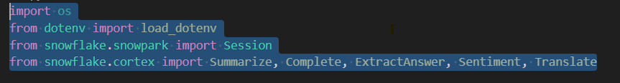
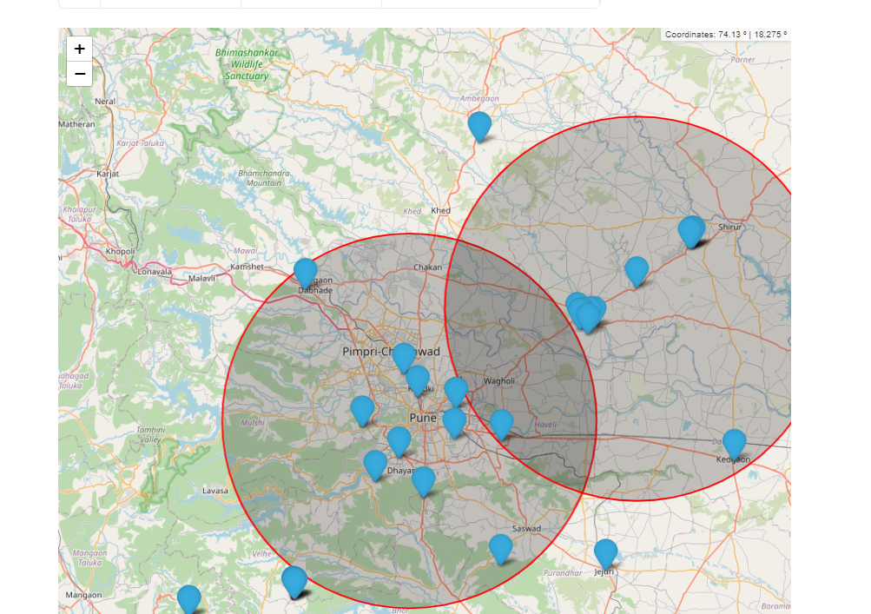
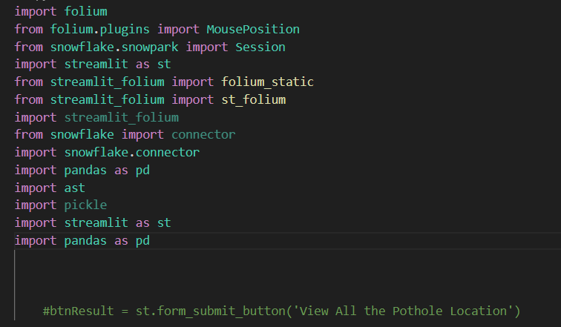
Lasts mile analysis App
< Insert Graph / Image / Video here >
We create simple app using snowflake and folium to demand new routes and stops for public. .---already built

Slide 9
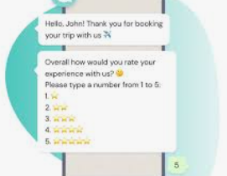
Insight and Recommendations #2
Insight
Title of Insight
We look at ways and means to make the Public Transportation more optimized.
We take various feedback from snowflake analysis regarding various amenities provided on transport .---already built

Slide 10
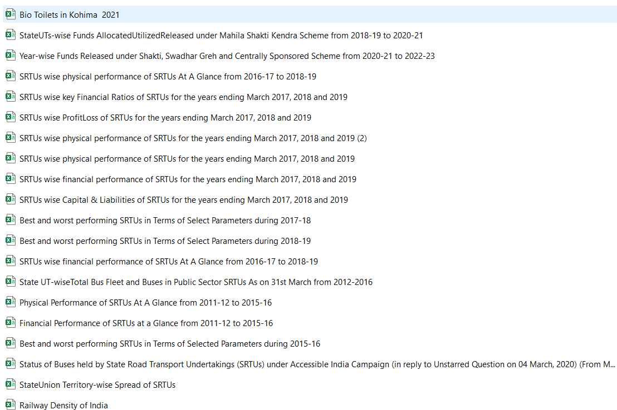

Insight and Recommendations #3
Insight
Title of Insight
We use various means to analyse and forecast trends based on data available.
We provide various visualisations to Public to raise their awareness using libraries like plotly.
We recommend new policies based on this to improve profits and public experience.

Slide 11
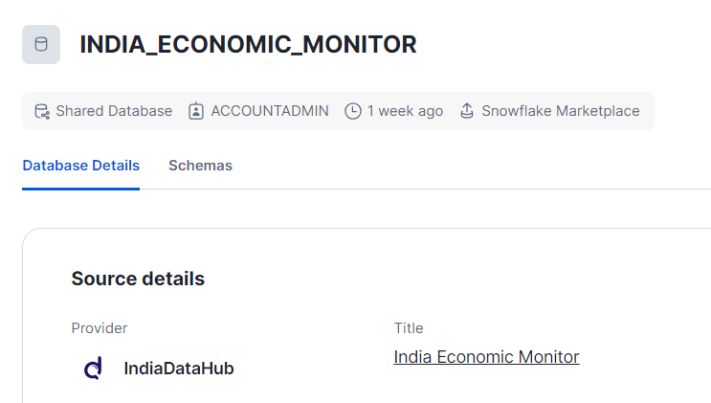
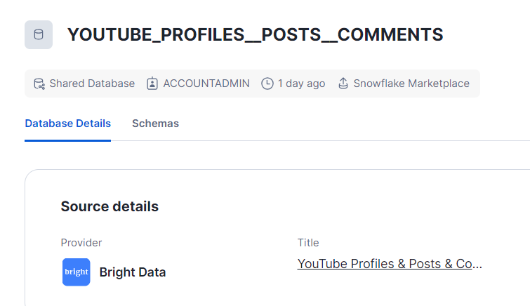

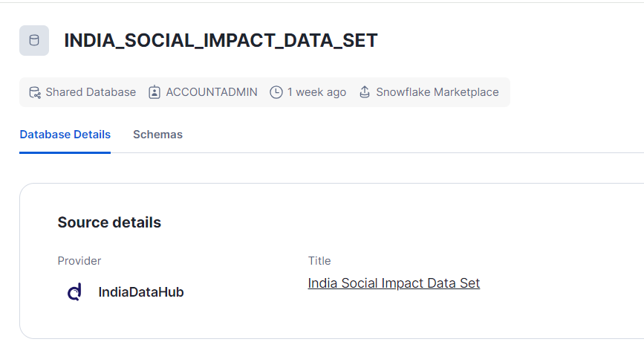
Dataset

Slide 12
THANK
YOU

